Slide 1
Potential Technologies

Slide 2

Option 1
Beautiful Soup
Selenium
APIs - (Tweepy)
Python
MongoDB
Pros
MongoDB is a type of NoSQL database
NoSQL databases are highly scalable and perform quickly
Cons
File based, which is not what the client wanted

Slide 3
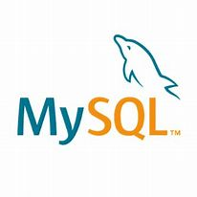
Option 2
Beautiful Soup
Selenium
APIs - (Tweepy)
Python
MySQL
Pros
MySQL "widely used, open-source relational DBMS"
High performance and easy for scalability
Cons
MySQL does not support a very large database size as efficiently
Justification
Easy integration
Development tools and environments
Connection with different programming languages

Slide 4

Option 3
Beautiful Soup
Selenium
APIs - (Tweepy)
Python
Oracle DB
Pros
Using API's means not having to, "recreate the wheel"
Don't have to worry as much about how to scrape vs what to scrape
Cons
Oracle DB not open-source
Costly

Slide 5
Citations
MongoDB vs. MySQL vs. Oracle Comparison (db-engines.com)
What are NOSQL Skills | How NOSQL Skill Helps to Build Big Data Career (educba.com)
https://www.datamation.com/storage/8-major-advantages-of-using-mysql/

